Slide 1
How Does Neocortex Learn?
Randall C. O’Reilly

Slide 2
Mysterious Neocortex!
We know more about most other brain areas:
- BG, Cerebellum, Hippocampus..
Neocortex is the most amorphous and plastic!
That makes it hardest to understand..
and yet learning is the most important thing neocortex does..

Slide 3
Bottom-up vs. Top-down
Could start with biology and derive learning..
STDP etc
or start with computation and derive biology..
Backpropagation pretty much only thing that works
or do a constraint satisfaction process that integrates both factors..

Slide 4
Overview
Biology: synaptic plasticity
Computation:
Self organizing – soaking up statistics
Error-driven – getting the right answers
Prediction: where the errors come from?
Detailed backprop models

Slide 5
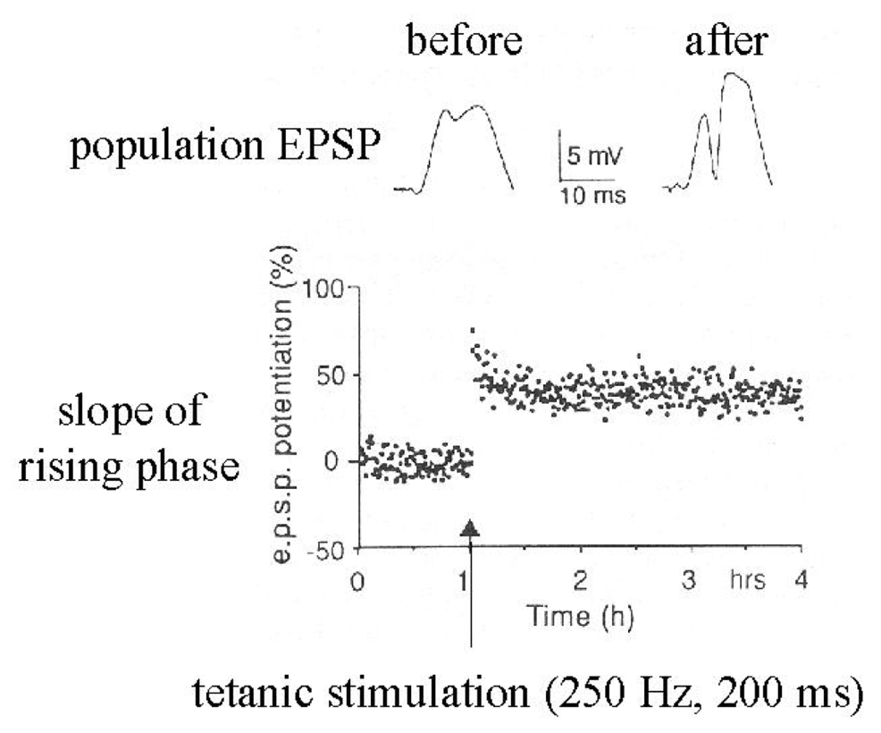
Synapses Change Strength (in response to patterns of activity)

Slide 6
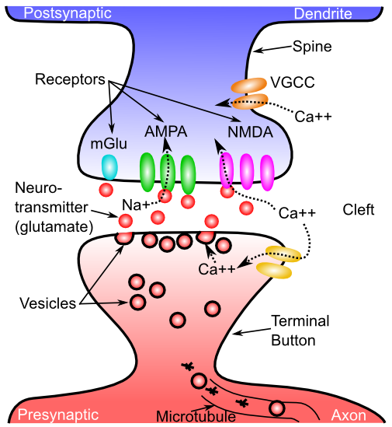
What Changes??

Slide 7
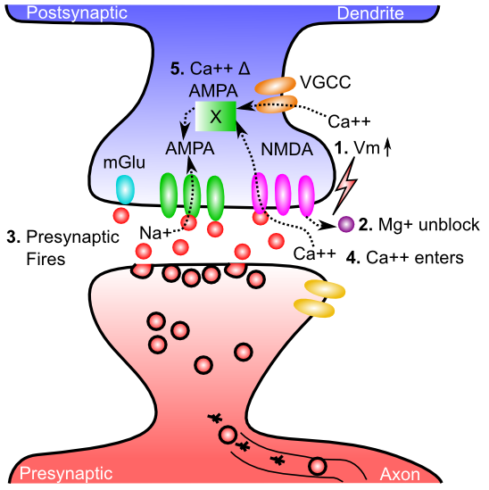
Gettin’ AMPA’d

Slide 8
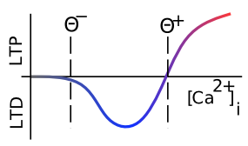
Which Way?

Slide 9
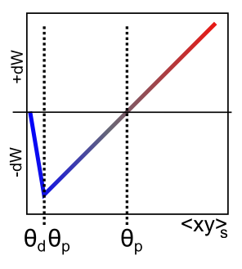
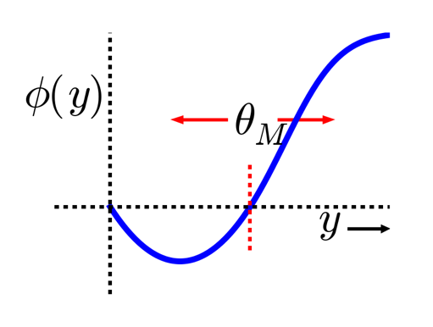
XCAL = Linearized BCM
Bienenstock, Cooper & Munro (1982) – BCM:
adaptive threshold Θ
Lower when less active
Higher when more..
(homeostatic)

Slide 10
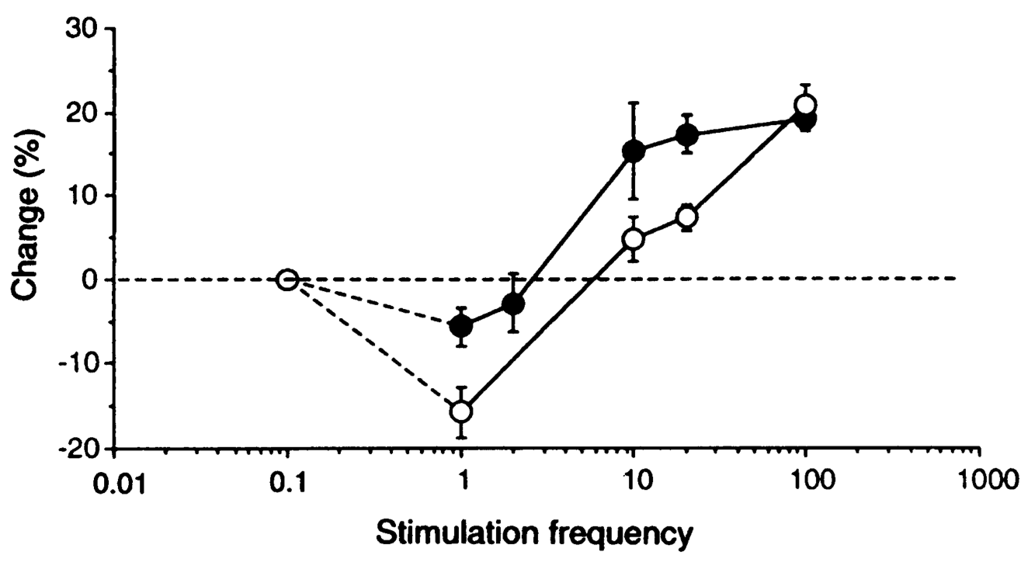
Threshold Does Adapt

Slide 11
Computational: Self-Organizing and Error-Driven
Self-organizing = learn general statistics of the world.
Error-driven = learn from difference between expectation and outcome.
Both can be achieved through XCAL.

Slide 12
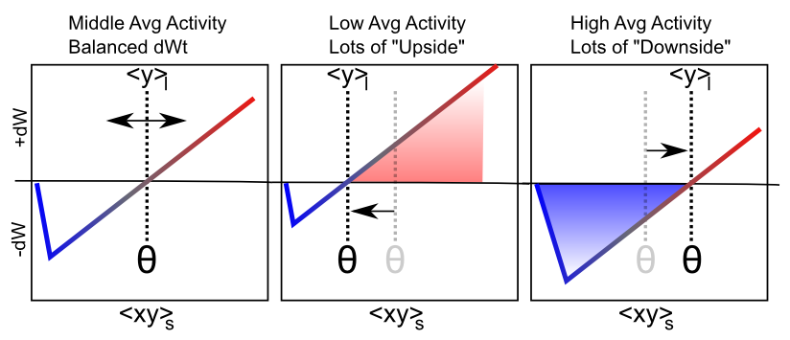
Floating Threshold = Long Term Average Activity (Self Org)

Slide 13
Self Organizing Learning
Inhibitory Competition: only some get to learn
Rich get richer: winners detect even better
But also get more selective (hopefully)
Homeostasis: keeping things more evenly distributed (higher taxes for the rich!)

Slide 14
Limitations of Self-Organizing
Can’t learn to solve challenging problems – driven by statistics, not error..

Slide 15

Floating Threshold = Medium Term Synaptic Activity (Error-Driven)
dW = Outcome – Expectation = <xy>_{s} - <xy>_{m}

Slide 16
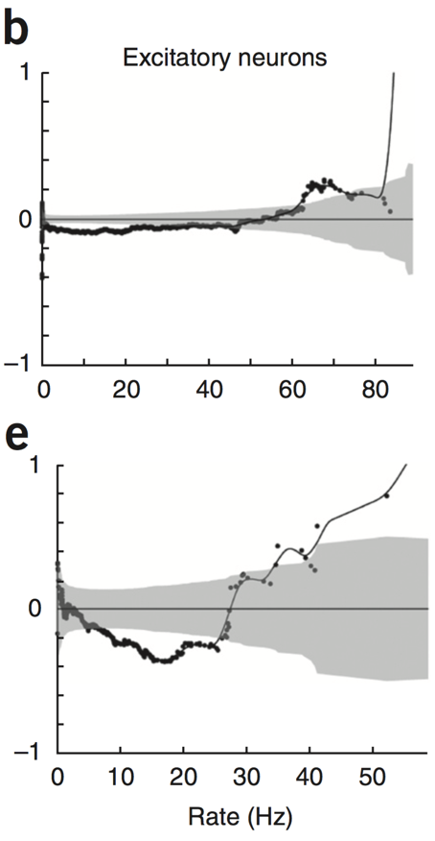
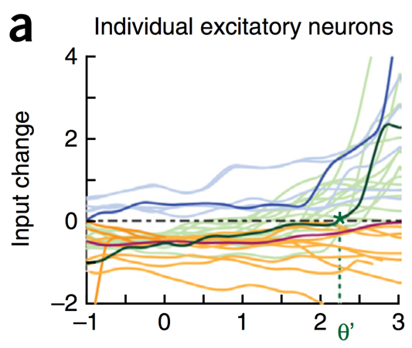
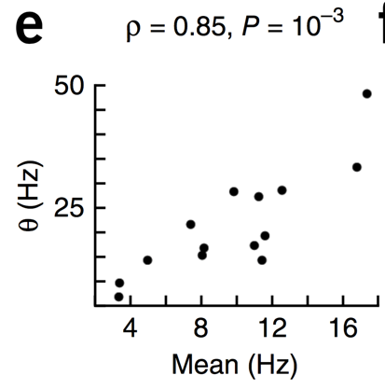
Evidence of Dynamic Thresholds (Lim, McKee, Woloszyn et al., 2015)
b = passive viewing
e = active task
Threshold changes dynamically on a rapid time scale, as a function of short-term activity level!

Slide 17
Biological Derivation of XCAL Curve
Can use a detailed model of Spike Timing Dependent Plasticity (STDP) to derive the XCAL learning curve
Provides a different perspective on STDP..

Slide 18
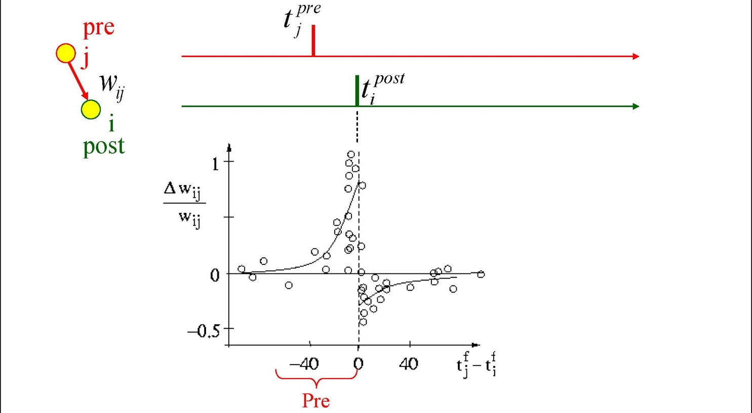
Causal Learning?

Slide 19
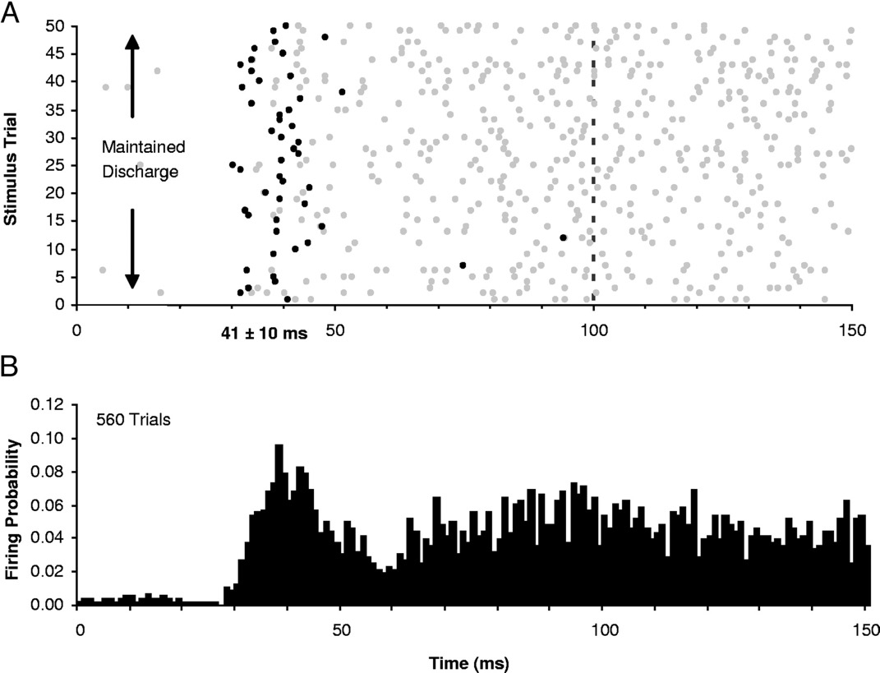
Let’s Get Real..

Slide 20
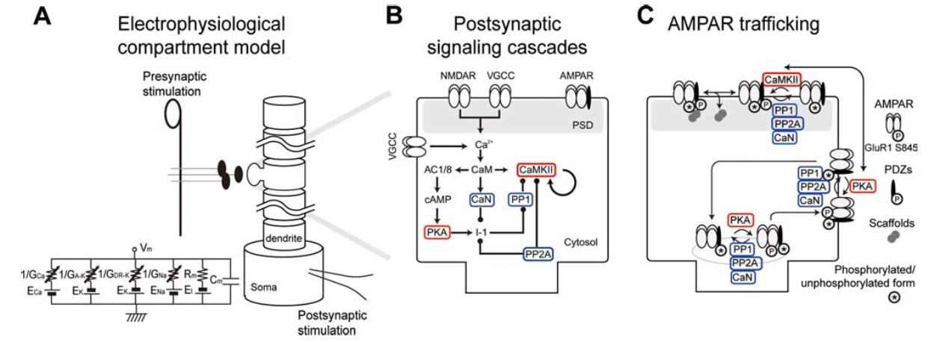
Urakubo et al, 2008 Model
Highly detailed combination of 3 existing strongly-validated models:

Slide 21
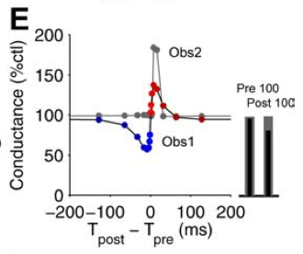
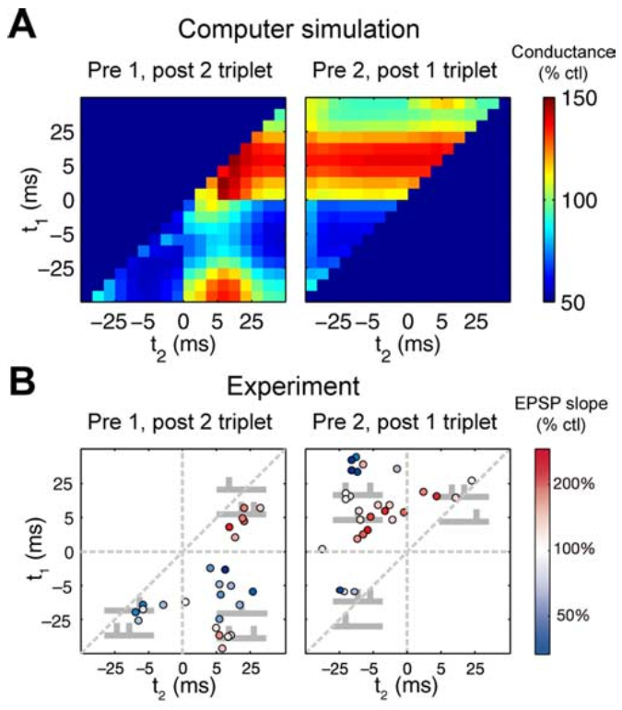
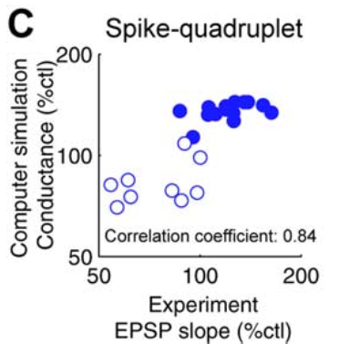
“Allosteric” NMDA Captures STDP (including higher-order and time integration effects)

Slide 22
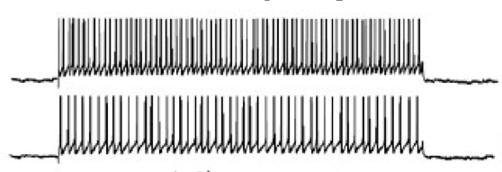
What About Real Spike Trains?

Slide 23
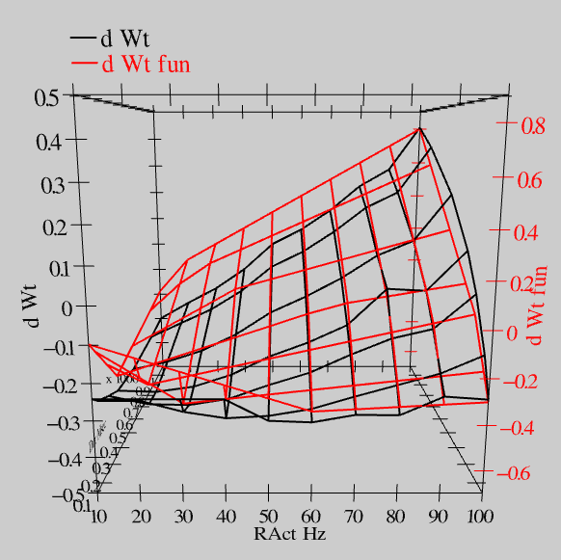
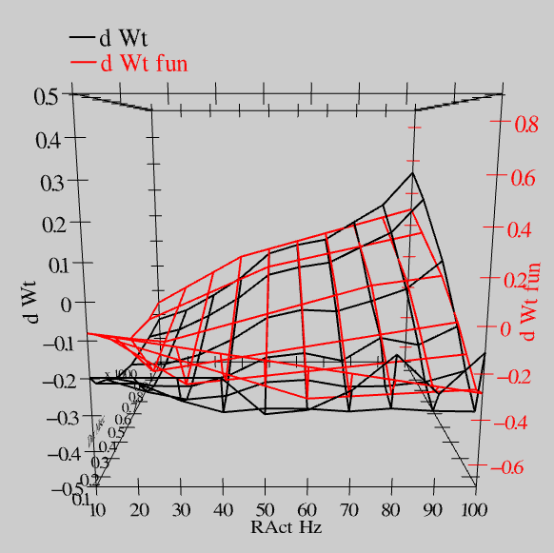
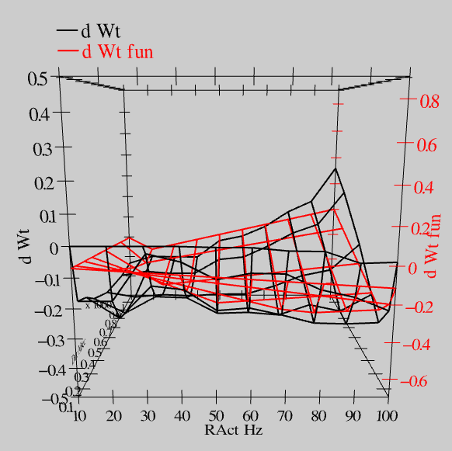
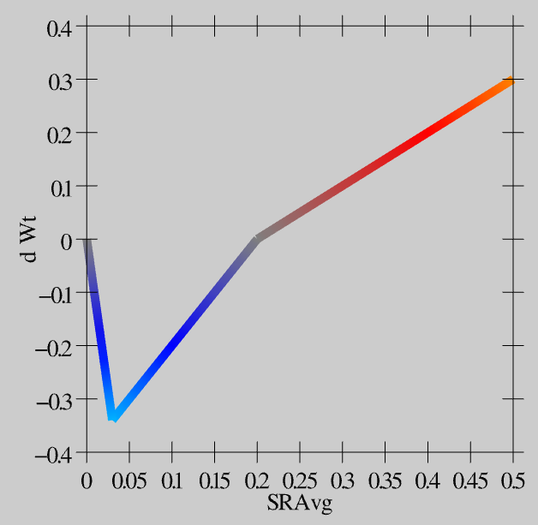
Extended Spike Trains = Emergent Simplicity
S = 100Hz
S = 50Hz
S = 20Hz
dW = f(send * recv) =
(spike rate * duration)
r=.894

Slide 24
Deep Convolutional Neural Nets
Solve the invariant recognition problem; high performance,
but dependent on huge datasets of hand-labeled images
Baby does not have access to these labels!
(and monkey certainly doesn’t!)

Slide 25
Where Does Error Come From?

Slide 26
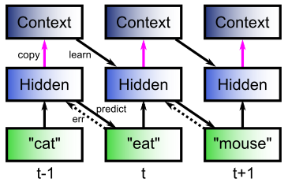
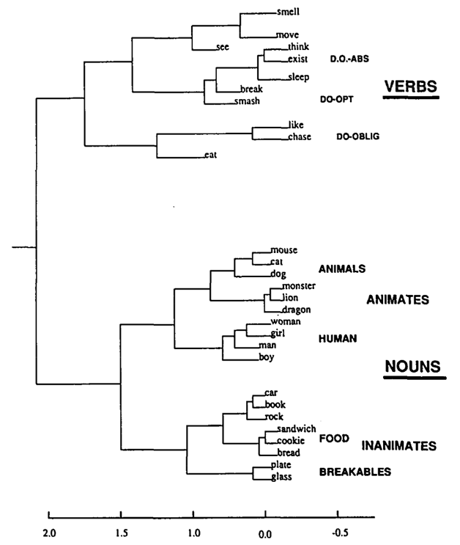
The Predictive Bootstrap (Elman 1990; Elman, Bates, et al. 1996)
Learning to predict words induces verb vs noun category representations in hidden layer of SRN
The future is free!
If you can predict it, you know it!

Slide 27
Predictive Models: use model inferred on prior sensory input to predict next sensory input vs.
Generative Models: typically iteratively infer model from current sensory input, and then “predict” that same sensory input.

Slide 28
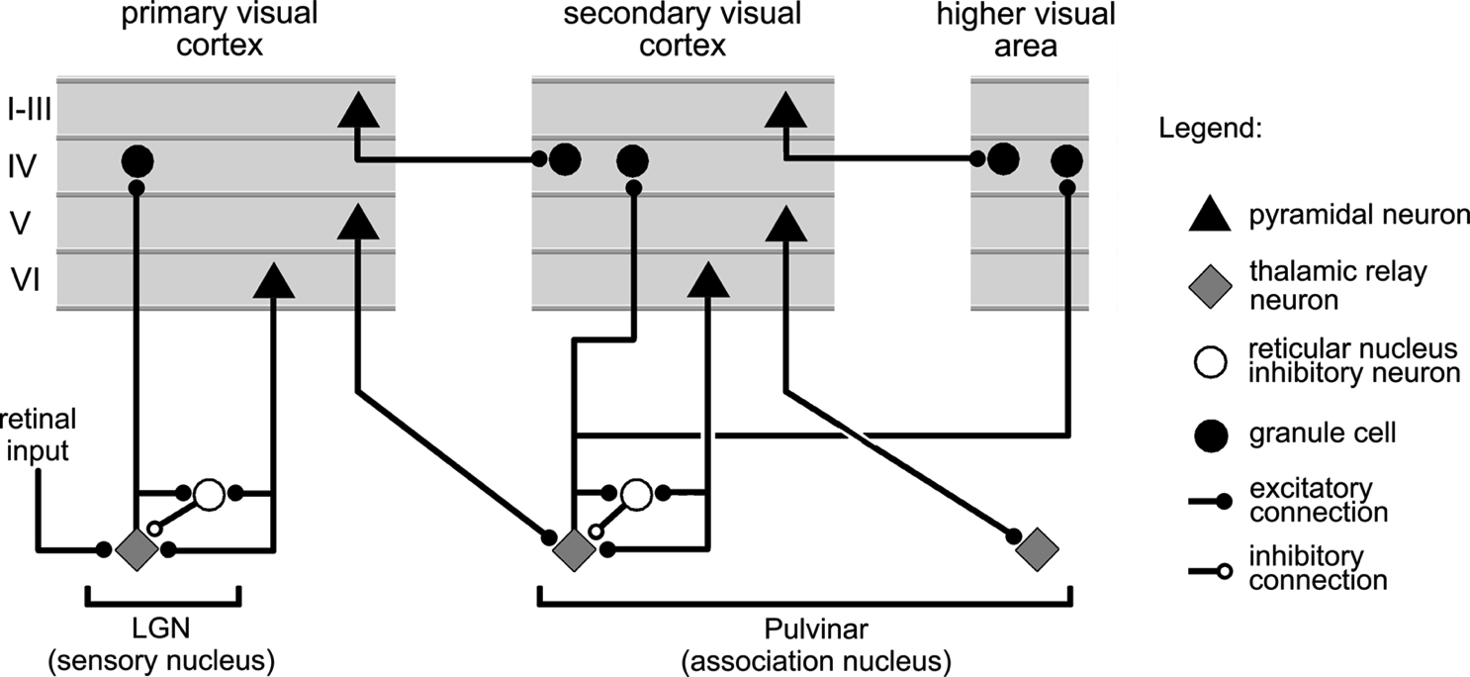
Thalamocortical Loop Biology (Sherman & Guillery, 2006)
5IB
FF
Driver
Weak
FB
“What happens”
Prediction

Slide 29
The Pulvinar = Projection Screen (c.f. Mumford, 1991 “blackboard”)
Pulvinar receives connections from all over visual cortex
and projects back out to these same areas
Two qualitative inputs:
1. Few strong driving inputs – feedforward
2. Many weaker feedback “modulatory” connections
Pulvinar!

Slide 30
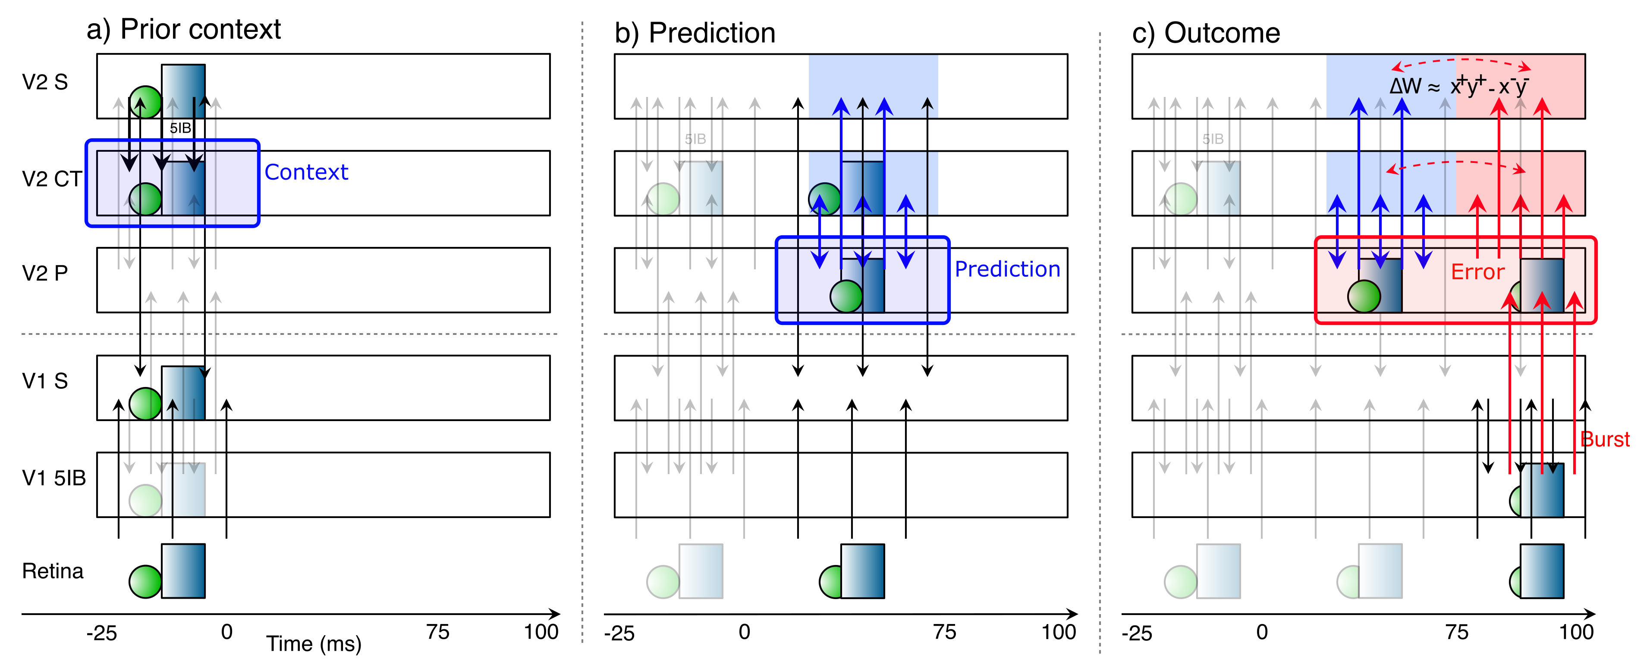
Learning through Time

Slide 31
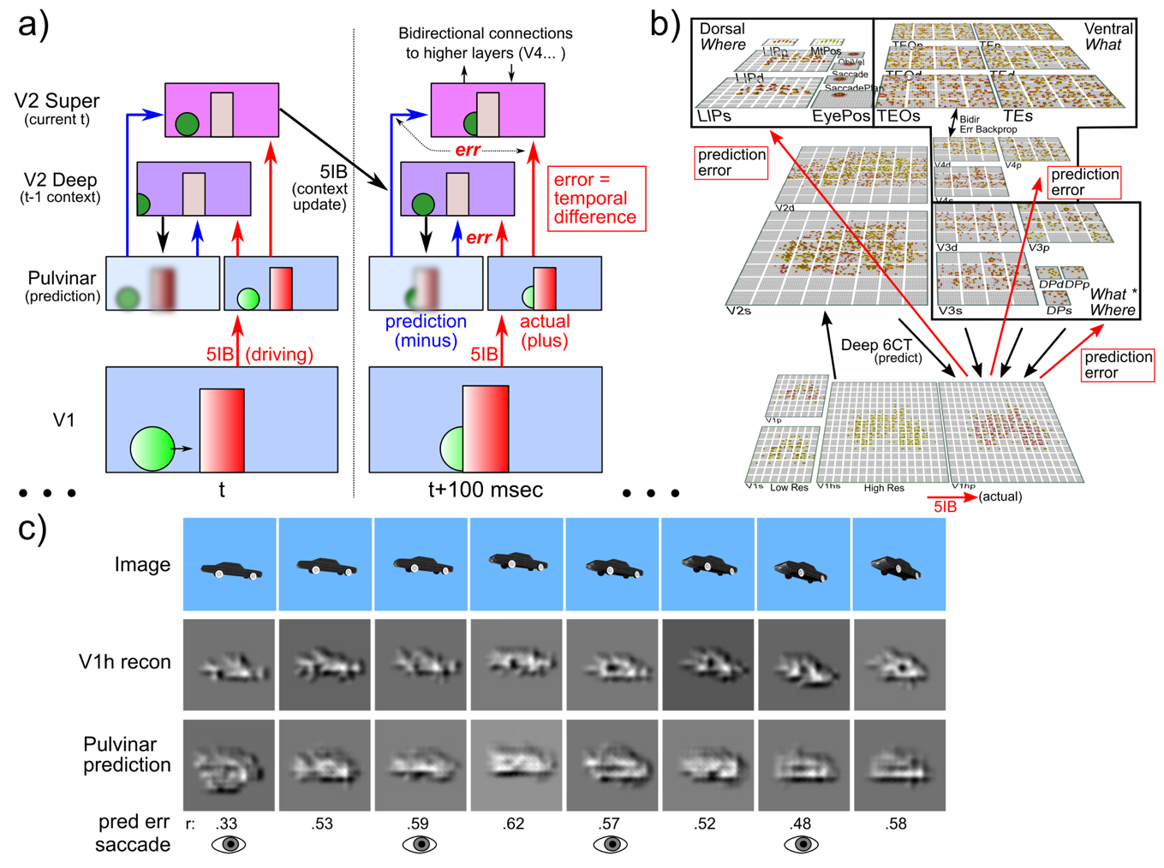
Deep Predictive Learning

Slide 32
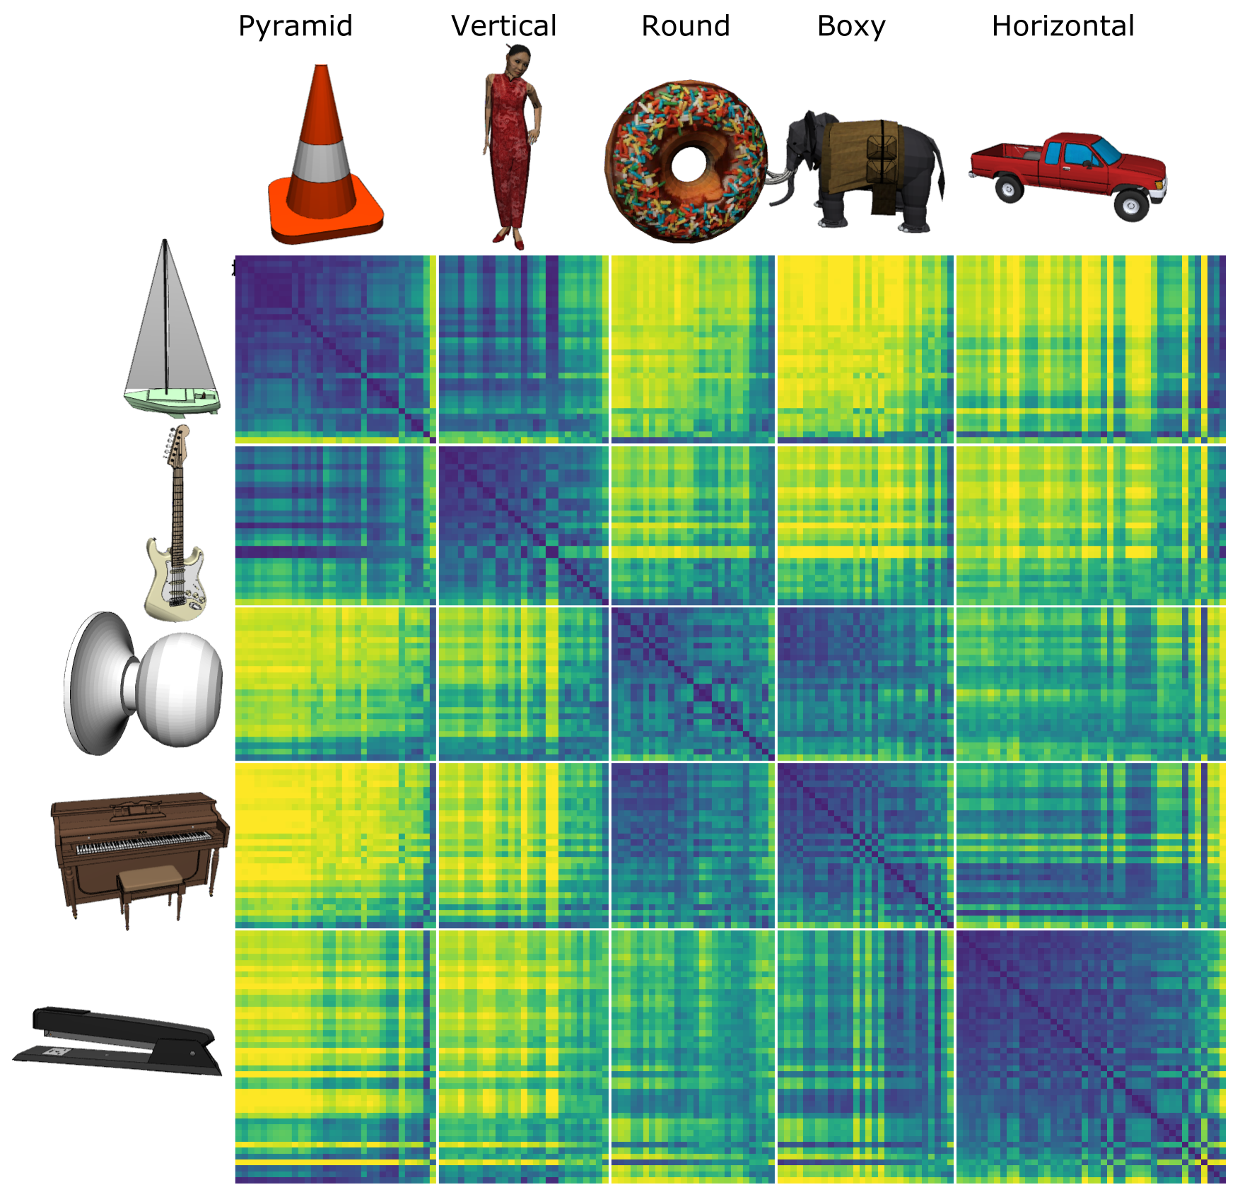
Model discovered
Shape categories!

Slide 33
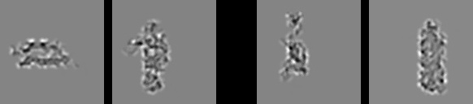
Model vs. Humans
Which pair is more similar in terms of overall shape?

Slide 34

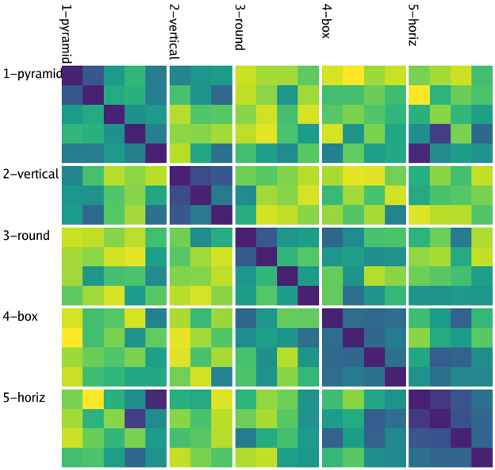
Model
People

Slide 35
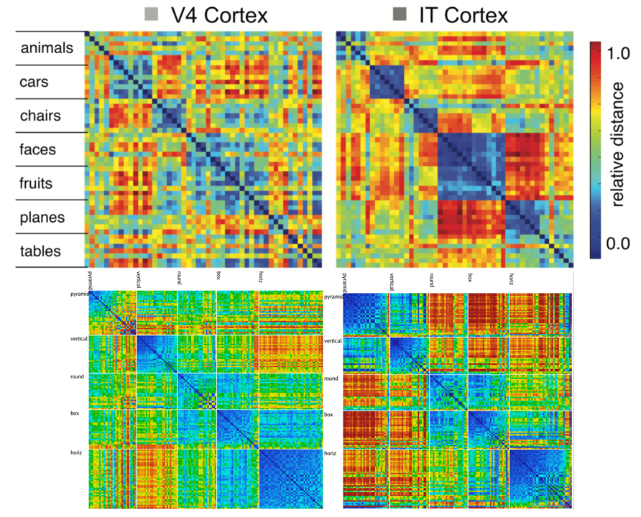
Model vs. Monkeys

Slide 36
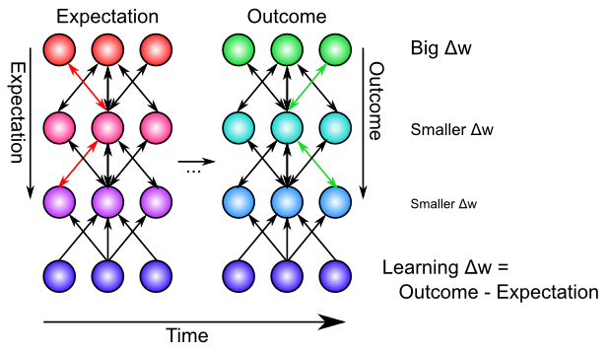
Backpropagation: Mathematics of Error-driven Learning

Slide 37
Backpropagation & GeneRec

Slide 38
GeneRec: Derivative Approximation

Slide 39
Whittington & Bogacz: Bio Backprop Ideas
Temporal-Error Models
Generec
Continuous Update model (Bengio et al, 2017)
Key problem: when is the “plus phase”?
“In such sensory prediction tasks, the target (i.e., the next ‘frame’ of sensory input) always arrives, so the temporal-error models may be particularly suited for this task, as there is no need for the control signal indicating target presence.”
Explicit-Error Models
“intricate architectures”, one-to-one connections (no evidence for, or for explicit error activity)
Only 15% inhibitory neurons!

Slide 40
Key Difference
Top-down vs. bottom-up = error, or attractor?
Hopfield model: bidirectional excitatory connections do constraint satisfaction – find input that best fits top-down and bottom-up.

Slide 41
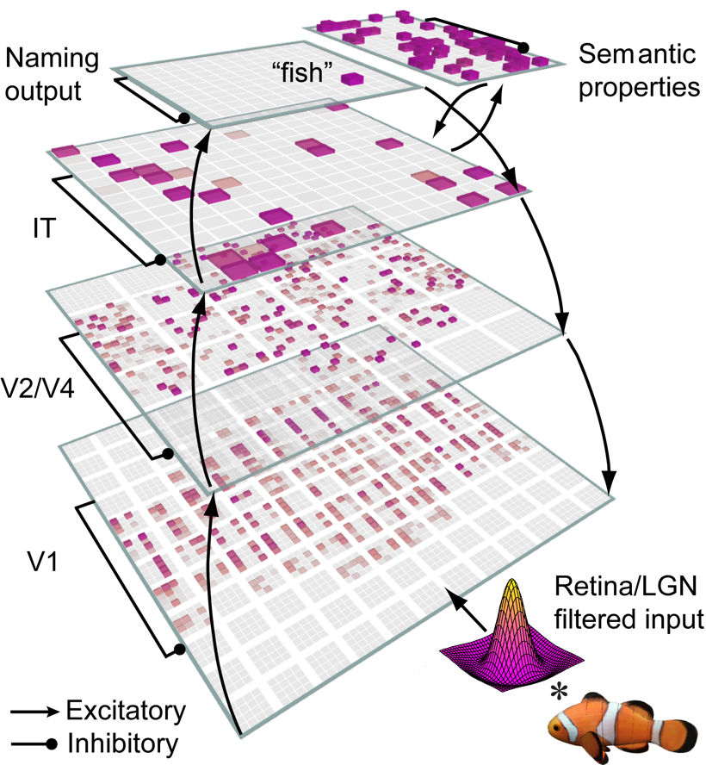
Bidirectional Object Recognition (e.g., O’Reilly et al., 2013)
100-way invariant object recognition

Slide 42
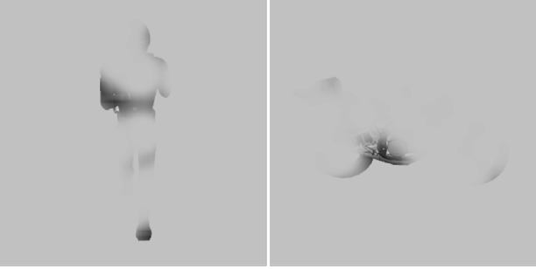

Benefit of Bidirectionality: Robust to Partial Occlusion

Slide 43
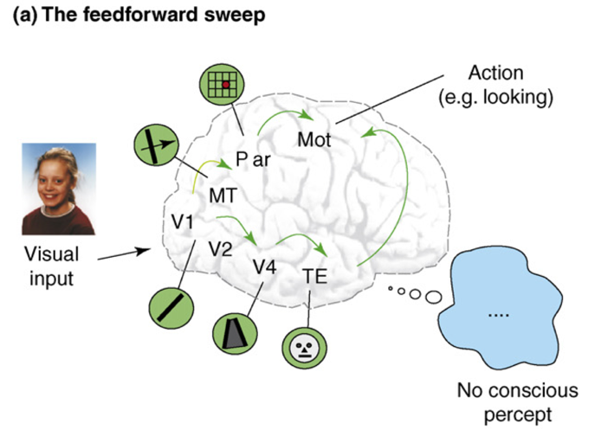
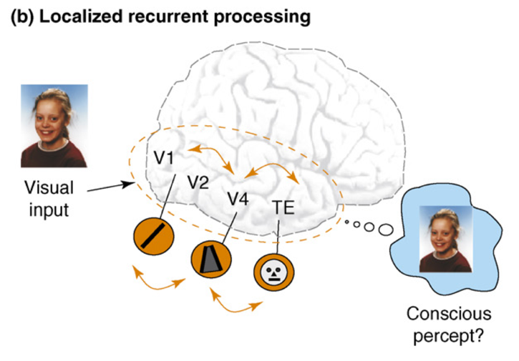
Recurrent Processing -> Consciousness (Lamme, 2006)
Consciousness is Unitary
Recurrence coordinates all areas on one thing (emerges via popular vote)
Consciousness is Functional
Helps organize, prioritize behavior – “focusing” key for difficult problems
Consciousness Flows
Temporal dynamics and information processing (multi-step cognition)

Slide 44
Extras

Slide 45
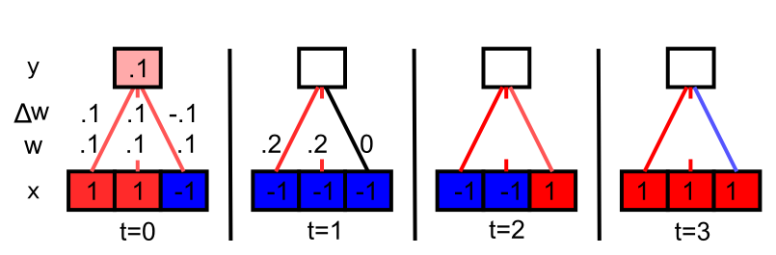
Hebbian Learns Correlations

Slide 46
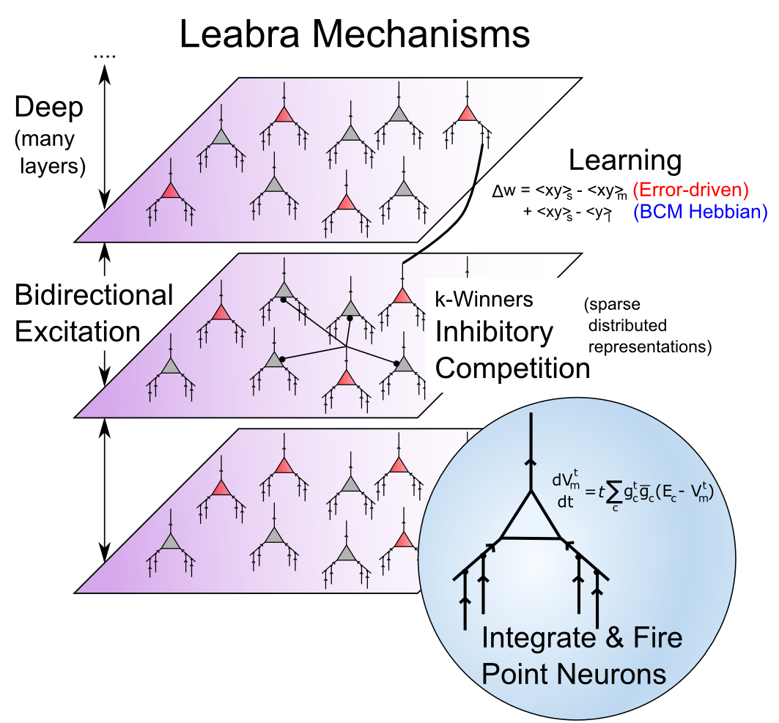
Leabra

Slide 47

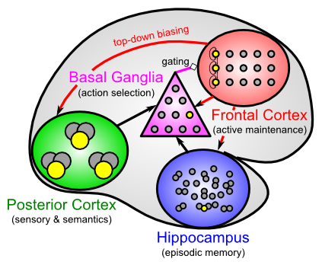
Leabra Biologically-based Cognitive Architecture
LSTM
Same framework accounts for wide range of cognitive neuroscience phenomena: perception, attention, motor control and action selection, learning & memory, language, executive function – all built out of the same neurons.
http://ccnbook.colorado.edu

